Slide 1
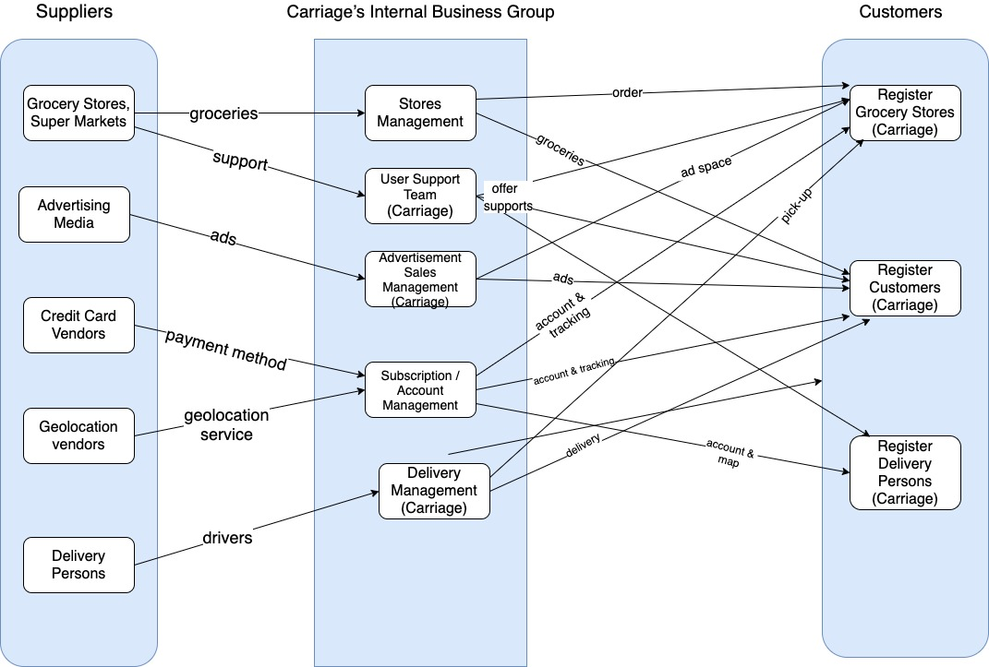
Online Grocery Delivery Application - ‘Carriage’ Business Relationship Map

Slide 2
User Roles by Business Group
External Users (Customers)
Unregister Customers (Jevon)
Register Customers (Tianqi)
Participating Grocery Stores (Lang)
Register Deliverers (Mady)
Internal Users
Business Group | User Roles | Team Member Name (Bus. Group Proxy)
Advertisement Sales Management | Advertisement Sales Representatives Pricing optimization & final ad rate analyst Digital Advertising Management Specialist Market researcher of new advertising sales techniques. | Maisha
User Support Team | User Support Team | Lang
Delivery Management | Delivery Management Representative (Manage a delivery team to ensure timely and accurate customer deliveries.) | Mady

